Slide 1

Moovie
Web Programming Application Project
Ryhmä 2
Pilar Murcia Pozuelo
Yvonne Frankort
Markku Putaala
Petteri Pätsi

Slide 2
Features
Documentation
Responsiveness | ✅
Sign Up | ✅
Sign In | ✅
Delete Account | ✅
Search | ✅
Now In Cinemas | ✅
Add member | ✅
Delete member | ✅
Groups | ✅
Groups Page Customization | ✅
Movie Reviews | ✅
Browse Reviews | ✅
Favourites List | ✅
Share Favourites List | ✅
Optional Feature | ✅
Class Diagram from the DB | ✅
User Interface Design | ✅
REST Documentation (Swagger) | ✅
Development Queue Management (Backlog) | ✅
Version Control (GitHub) | ✅
Projektin hallinta | ✅
Automatic Unit Tests
Sign In | ✅
Log Out | ✅
Sign Up | ✅
Delete Account | ✅
Browse Reviews | ✅

Slide 3
Roles
Teamwork
Scrum Master
Frontend
Backend
Database
Full-Stack
Open communication
Feedback
Clear rules
Collaboration
Trust

Slide 4
Hours/Person
Backlog → GitHub
Yvonne = 168 hours
Markku = 187 hours
Petteri = 123 hours
Pilar = 159 hours

Slide 5
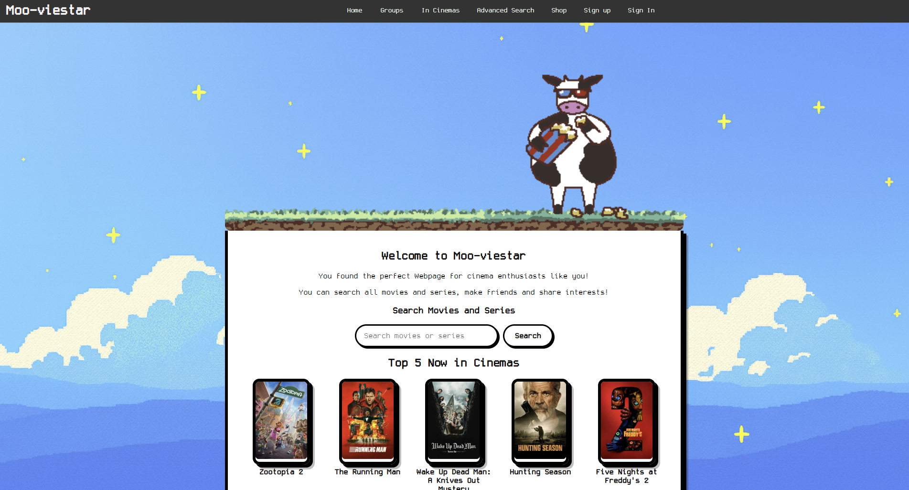
Our Web App
Link (Hosted in Railway)

Slide 6


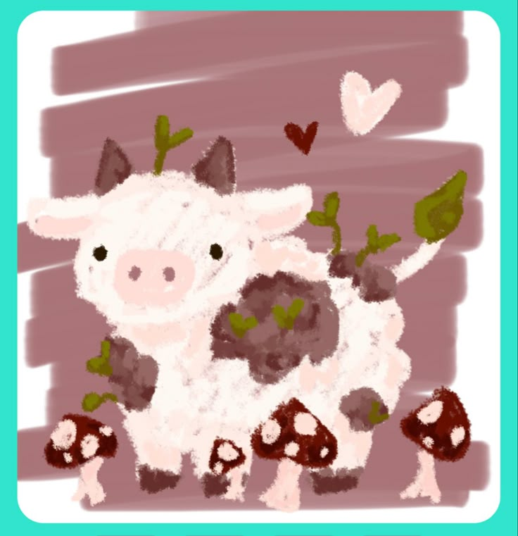











What was … ?
New
Docker
Backlog
Swagger
Challenging
Tests
Merging code
Resolving conflicts
Tests
Successful
The Project itself
The Visuals
Teamwork

Slide 7
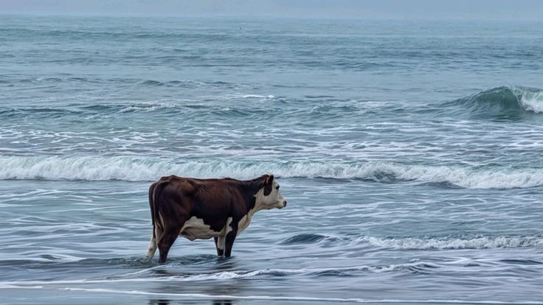
Thank you

